Slide 1
CSDS 451: Designing High Performant Systems for AI
Lecture 21
11/11/2025
Sanmukh Kuppannagari
sanmukh.kuppannagari@case.edu
https://sanmukh.research.st/
Case Western Reserve University

Slide 2
Outline
Distributed Matrix Multiplication on Cluster
Collective Communication Primitives

Slide 3
Announcements
WA3 Due this Saturday
WA4 Will be Out
Project Proposals Graded
If you did not receive a score, I may have asked you followup questions on your proposal
Please send me weekly updates by responding to the email so that you remain on track

Slide 4
Outline
Distributed Matrix Multiplication on Cluster
Collective Communication Primitives

Slide 5
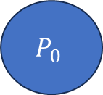
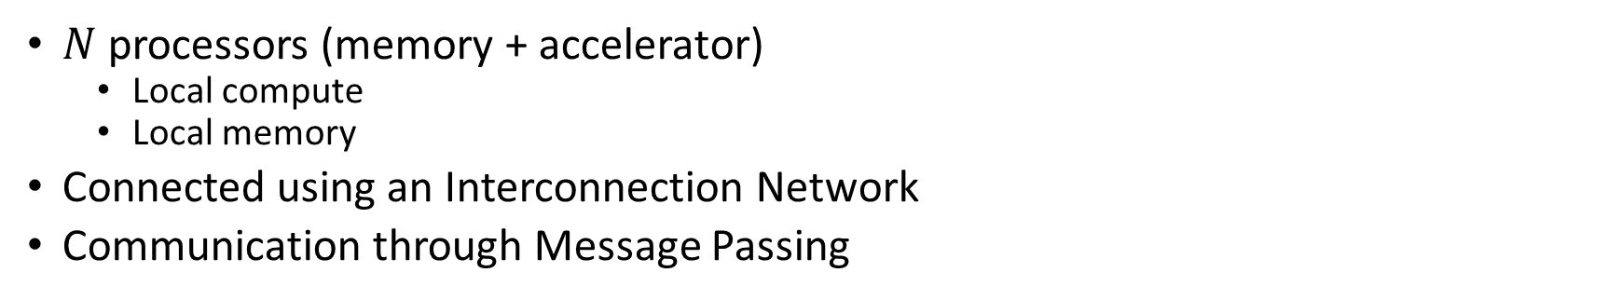
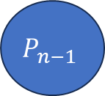
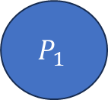
Cluster of Accelerators
$N$ processors (memory + accelerator)
Local compute
Local memory
Connected using an Interconnection Network
Communication through Message Passing
Interconnection Network
$$P_{0}$$
$$P_{1}$$
$$P_{n−1}$$
…

Slide 6
Anatomy of an MPI Program
MPI_Init(…)
MPI_Comm_rank(MPI_COMM_WORLD, &my_rank)
MPI_Comm_size(MPI_COMM_WORLD, &num_procs);
Do rank specific work

Slide 7
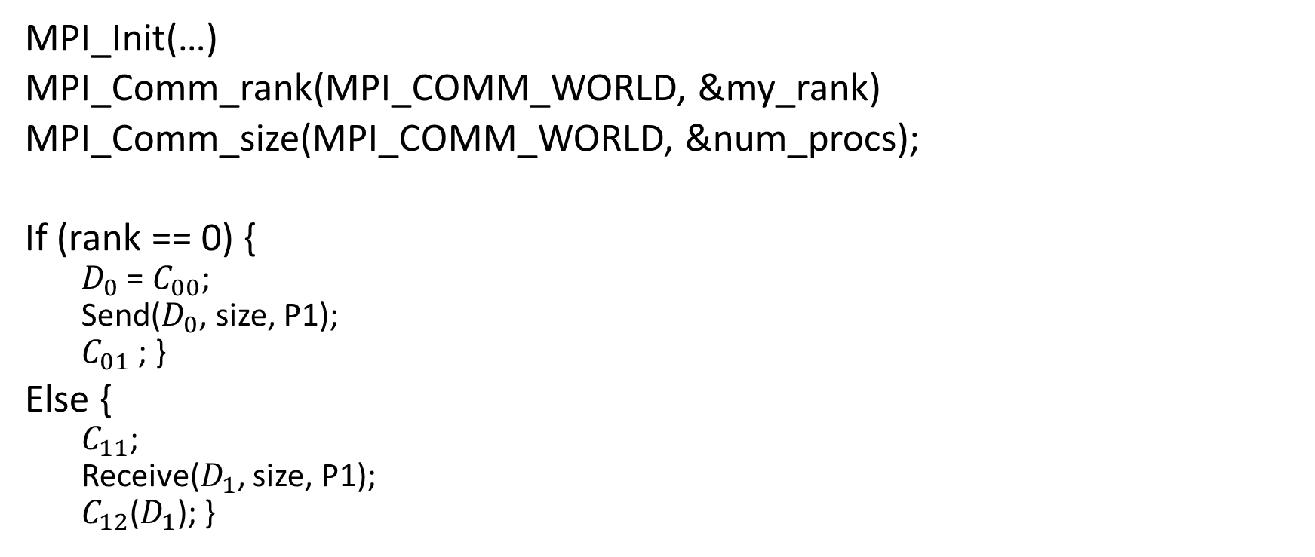
Inter-Process Communication
MPI_Init(…)
MPI_Comm_rank(MPI_COMM_WORLD, &my_rank)
MPI_Comm_size(MPI_COMM_WORLD, &num_procs);
If (rank == 0) {
$D_{0}$ = $C_{00}$;
Send($D_{0}$, size, P1);
$C_{01}$ ; }
Else {
$C_{11}$;
Receive($D_{1}$, size, P1);
$C_{12}$($D_{1}$); }
Rank 0
Rank 1
Data local to program₀
Data local to program₁
Two processor world

Slide 8
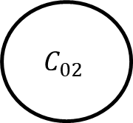
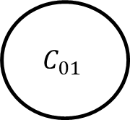
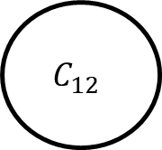
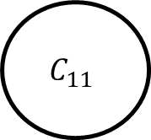
Inter-Process Communication
P0
P1
$$C_{01}$$
$$C_{11}$$
$$C_{02}$$
$$C_{12}$$
Dependency across processors due to communication operation

Slide 9
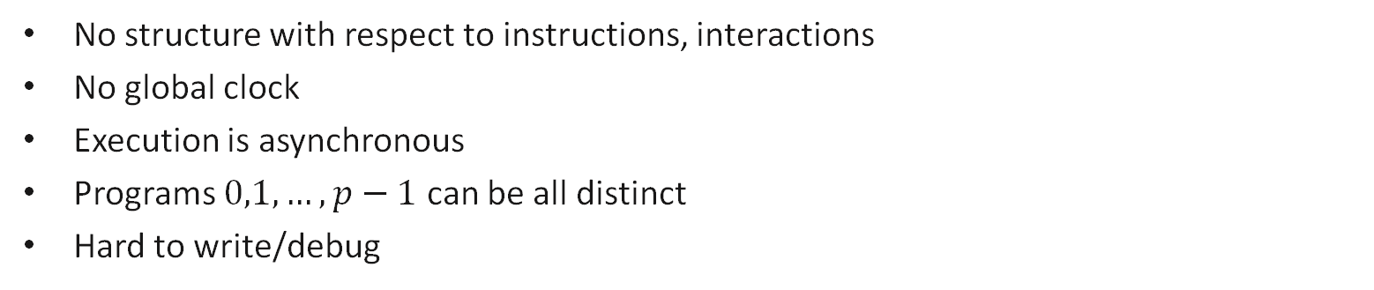
Message Passing Program
Most General Model: Asynchronous
Program₀
Program₁
Program₂
S
S
R
……
R
R
S
R
S = send
R = receive
S
End
End
End
No structure with respect to instructions, interactions
No global clock
Execution is asynchronous
Programs $0,1,…, p−1$ can be all distinct
Hard to write/debug

Slide 10
Message Passing Program
Bulk synchronous
Program₀
Program₁
Program₂
Program₃
Program₄
Computation phase
Communication phase
sync
Two phases to the Program
Computation Phase: Each process executes independently. No communication
Communication Phase: Processes communicate with each other

Slide 11
Message Passing Program
SPMD (Single Program Multiple Data)
Code is same in all the processes except for initialization
Restrictive model, easy to write and debug
Easy to do performance analysis
Widely used in Machine Learning Training
Program₀
Program₁
Program₂
Program₃
Program₄
Program₄

Slide 12
Blocking Non-Buffered Send/Receive
Sending
process
Receiving
process
Sending
process
Receiving
process
Sending
process
Receiving
process
Request
to send
Request
to send
Send
Request
to send
Idle
okay
to send
Send
Idle
okay
Recv.
Recv.
data
Send
okay
Recv.
data
data
Sender comes first;
idling at sender
(b) Sender and Receiver come at about the same time;
idling minimized
(c) Receiver comes first;
idling at Receiver

Slide 13


Virtual Topology
Define the “connectivity pattern” of the processors
Helps us in developing more intuitive notions of message passing algorithms
Think of it as 1D versus 2D arrays. It will be hard to visualize matrix multiplication if we write algorithms using 1D arrays
$$0 1 p−1$$
…
…
$$0 1 p−1$$
…
1D Mesh
…
2D Mesh

Slide 14
Message Passing Programming Paradigm
User Specifies the following
Concurrency Model (BSP, SPMD, None/Asynchronous)
Processes: The number of processes and the work performed for each process
Send, receive that enable data (we will only use blocking non-buffered semantics)
A virtual topology of the processes
We will discuss it at algorithmic level.
Skip initialization, rank calculation, etc.

Slide 15
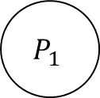
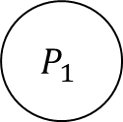
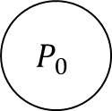
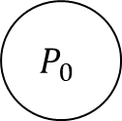




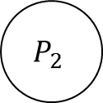
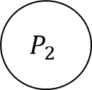
Message Passing Programming Paradigm
Note: We make the following assumption for simplicity
Each processor can communicate with a maximum of two processor at any given time
One communication – send
Other communication - receive
$$P_{0}$$
$P_{1}$ recv
$$P_{1}$$
$P_{1}$ send
$$P_{2}$$
$$P_{0}$$
$P_{1}$ send
$$P_{1}$$
$P_{1}$ send
$$P_{2}$$

Slide 16
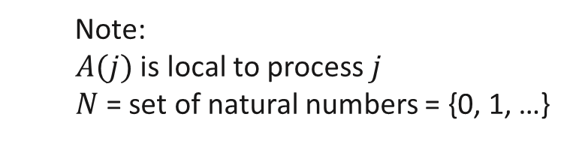


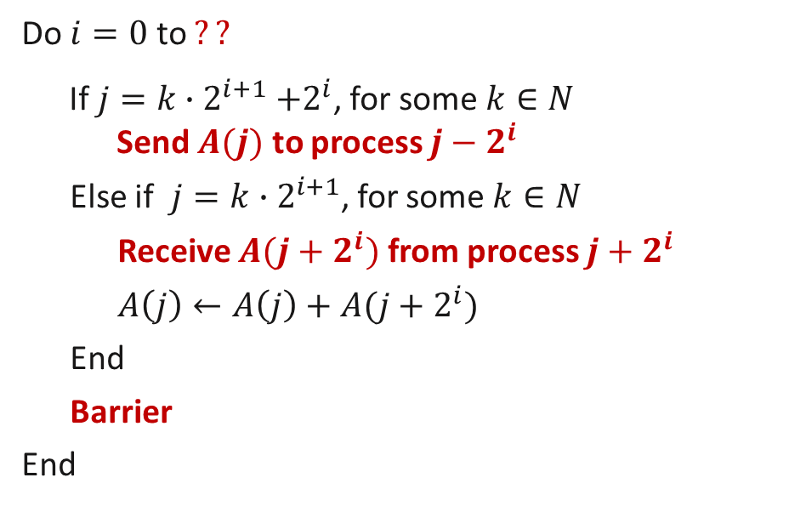
Adding Using Message Passing on 1D Mesh (6)
Message Passing Algorithm (SPMD model)
Program in process $j, 0≤j ≤n−1$
1.
Do $i=0$ to $??$
If $j=k{∙2}^{i+1}+2^{i}$, for some $k∈N$
Send $A(j)$ to process $j−2^{i}$
Else if $j=k∙2^{i+1}$, for some $k∈N$
Receive $A(j+2^{i})$ from process $j+2^{i}$
$A\left(j\right)←A\left(j\right)+A(j+2^{i})$
End
Barrier
End
2.
3.
$2^{i}$ distance communication
4.
5.
6.
7.
Note:
$A(j)$ is local to process $j$
$N$= set of natural numbers = {0, 1, …}
8.
9.

Slide 17
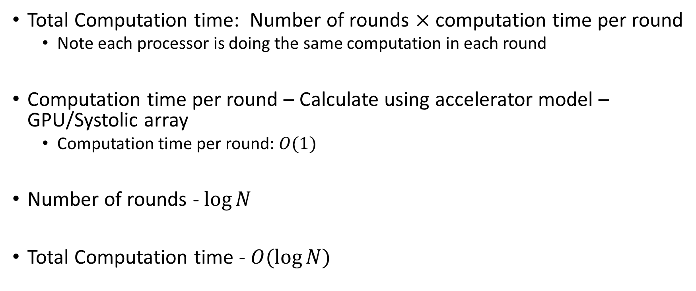
Performance Analysis (1)
Total Computation time: Number of rounds $×$ computation time per round
Note each processor is doing the same computation in each round
Computation time per round – Calculate using accelerator model – GPU/Systolic array
Computation time per round: $O(1)$
Number of rounds - $\log{N}$
Total Computation time - $O(\log{N})$

Slide 18
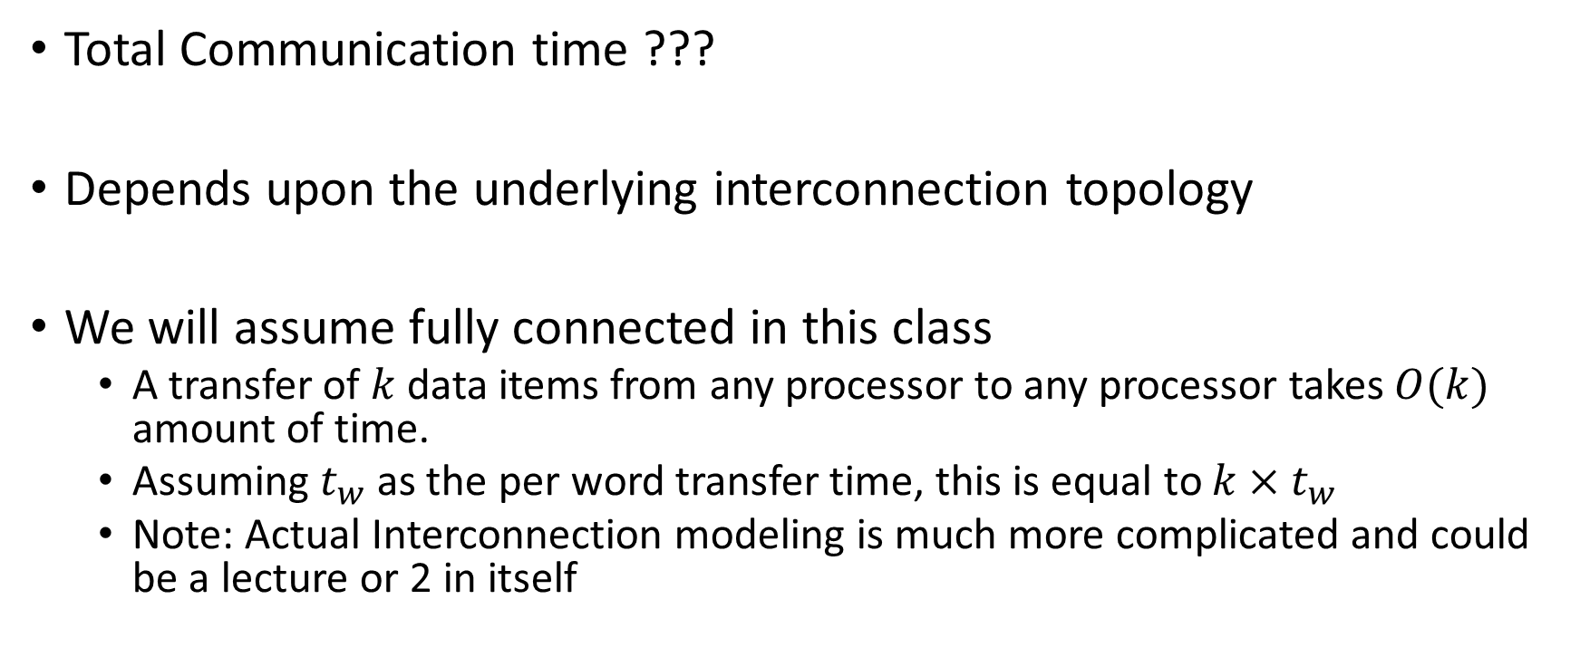
Performance Analysis (2)
Total Communication time ???
Depends upon the underlying interconnection topology
We will assume fully connected in this class
A transfer of $k$ data items from any processor to any processor takes $O(k)$ amount of time.
Assuming $t_{w}$ as the per word transfer time, this is equal to $k×t_{w}$
Note: Actual Interconnection modeling is much more complicated and could be a lecture or 2 in itself

Slide 19
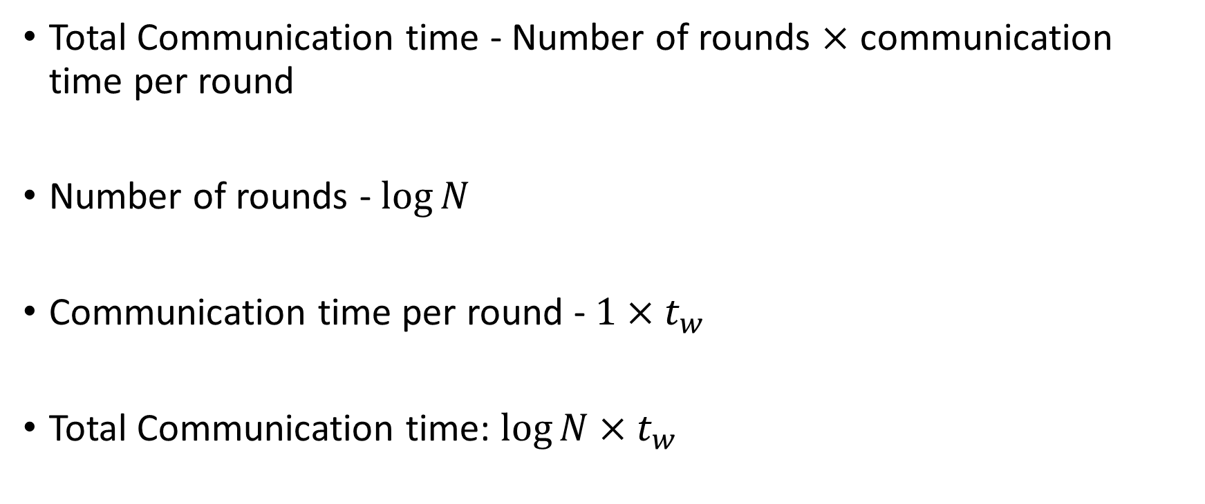
Performance Analysis (3)
Total Communication time - Number of rounds $×$ communication time per round
Number of rounds - $\log{N}$
Communication time per round - $1×t_{w}$
Total Communication time: $\log{N}×t_{w}$

Slide 20
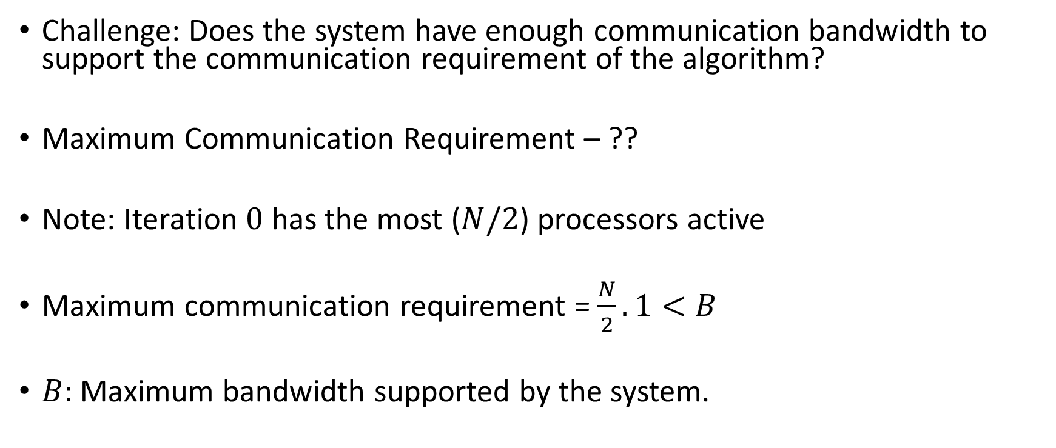
Performance Analysis (4)
Challenge: Does the system have enough communication bandwidth to support the communication requirement of the algorithm?
Maximum Communication Requirement – ??
Note: Iteration $0$ has the most ($N/2$) processors active
Maximum communication requirement = $\frac{N}{2}.1<B$
$B:$ Maximum bandwidth supported by the system.

Slide 21
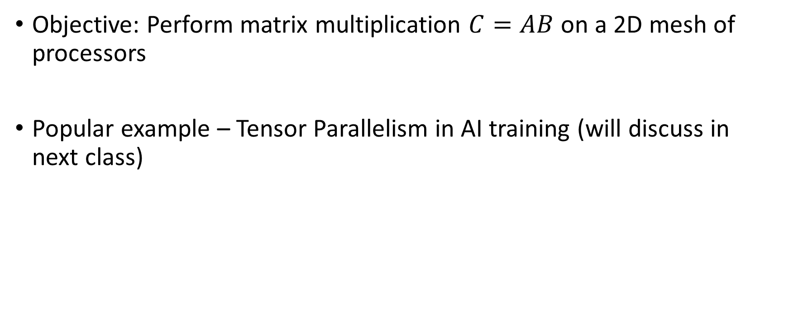
Distributed Matrix Multiplication
Objective: Perform matrix multiplication $C=AB$ on a 2D mesh of processors
Popular example – Tensor Parallelism in AI training (will discuss in next class)

Slide 22
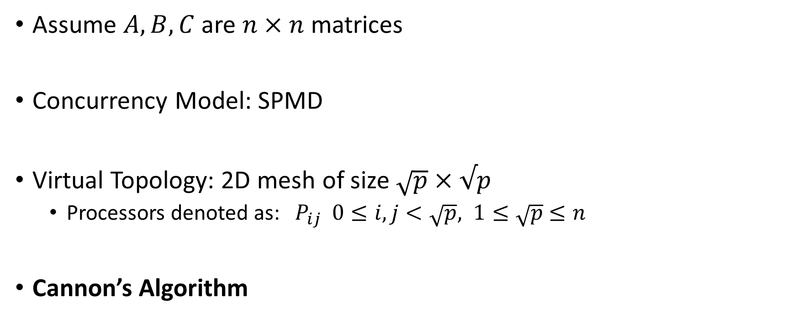
MM on 2D Mesh
Assume $A, B, C$ are $n×n$ matrices
Concurrency Model: SPMD
Virtual Topology: 2D mesh of size $\sqrt{p}×√p$
Processors denoted as: $P_{ij} 0≤i,j<\sqrt{p}, 1≤\sqrt{p}$ $≤n$
Cannon’s Algorithm

Slide 23

MM on 2D Mesh – Cannon’s Algorithm
Similar Idea as Blocked Matrix Multiplication
Processor $P_{ij}$ produces output block $C_{ij}$
What is the block size of $C_{ij}$?

Slide 24

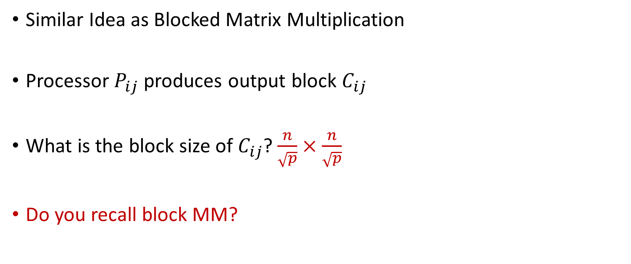


MM on 2D Mesh – Cannon’s Algorithm
Similar Idea as Blocked Matrix Multiplication
Processor $P_{ij}$ produces output block $C_{ij}$
What is the block size of $C_{ij}$? $\frac{n}{\sqrt{p}}×\frac{n}{\sqrt{p}}$
Do you recall block MM?
$B^{b}[$:,j]
$A^{b}[$i,:]
$C^{b}[$i,j]

Slide 25
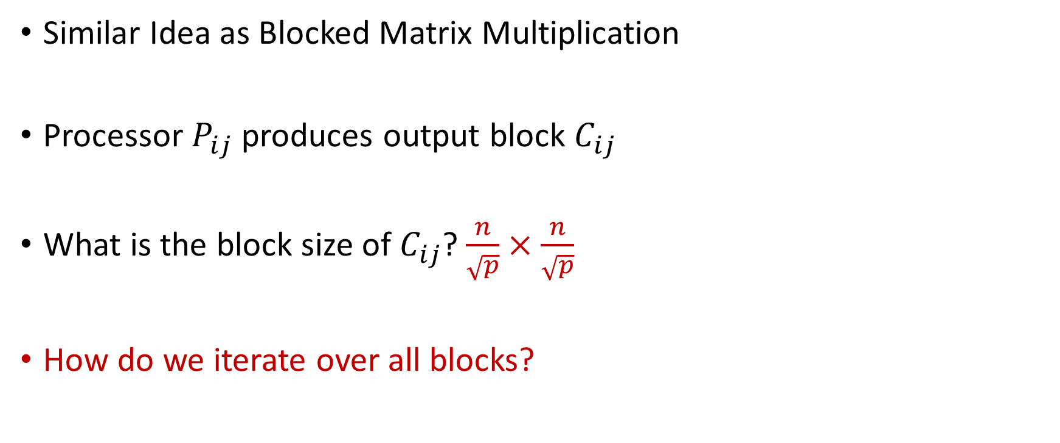
MM on 2D Mesh – Cannon’s Algorithm
Similar Idea as Blocked Matrix Multiplication
Processor $P_{ij}$ produces output block $C_{ij}$
What is the block size of $C_{ij}$? $\frac{n}{\sqrt{p}}×\frac{n}{\sqrt{p}}$
How do we iterate over all blocks?
$B^{b}[$:,j]
$A^{b}[$i,:]
$C^{b}[$i,j]

Slide 26
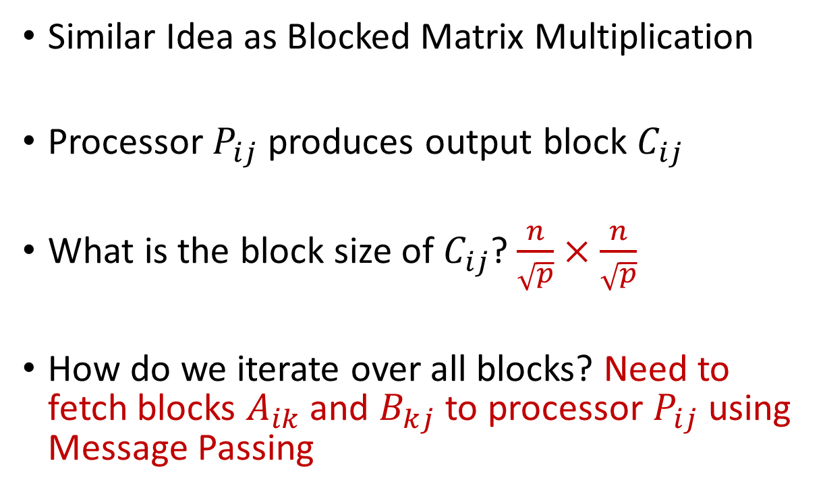
MM on 2D Mesh – Cannon’s Algorithm
Similar Idea as Blocked Matrix Multiplication
Processor $P_{ij}$ produces output block $C_{ij}$
What is the block size of $C_{ij}$? $\frac{n}{\sqrt{p}}×\frac{n}{\sqrt{p}}$
How do we iterate over all blocks? Need to fetch blocks $A_{ik}$ and $B_{kj}$ to processor $P_{ij}$ using Message Passing
$B^{b}[$:,j]
$A^{b}[$i,:]
$C^{b}[$i,j]

Slide 27
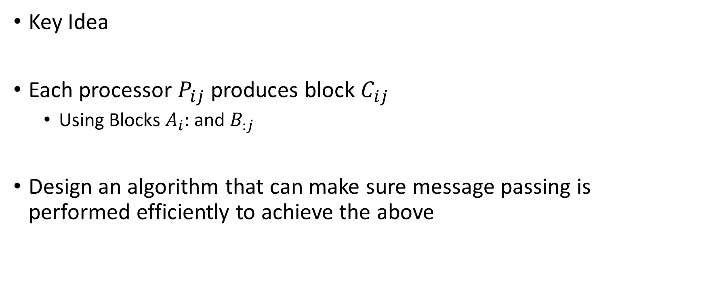
MM on 2D Mesh – Cannon’s Algorithm
Key Idea
Each processor $P_{ij}$ produces block $C_{ij}$
Using Blocks $A_{i}:$ and $B_{:j}$
Design an algorithm that can make sure message passing is performed efficiently to achieve the above

Slide 28
MM on 2D Mesh – Cannon’s Algorithm
For simplicity of discussion, we define two operations
Circular Left Shift on a row
Each processor sends a block of matrix to the processor on the left
Circular Up Shift on a column
Each processor send a block of matrix to the processor above it
Called by each processor in a row/column

Slide 29


MM on 2D Mesh – Cannon’s Algorithm
Circular left shift
Circular up shift
0
1
…
$\sqrt{p}$-1
0
…
$\sqrt{p}$-1

Slide 30
































MM on 2D Mesh – Cannon’s Algorithm
Assume initially $P_{ij}$ has data - $A_{ij}, B_{ij}$
$$A_{0,0}$$
$$A_{0,1}$$
$$A_{0,2}$$
$$A_{0,3}$$
$$B_{0,0}$$
$$B_{1,1}$$
$$B_{2,2}$$
$$B_{3,3}$$
$$A_{1,1}$$
$$A_{1,2}$$
$$A_{1,3}$$
$$A_{1,0}$$
$$B_{1,0}$$
$$B_{2,1}$$
$$B_{3,2}$$
$$B_{0,3}$$
$$A_{2,2}$$
$$A_{2,3}$$
$$A_{2,0}$$
$$A_{2,1}$$
$$B_{2,0}$$
$$B_{3,1}$$
$$B_{0,2}$$
$$B_{1,3}$$
$$A_{3,3}$$
$$A_{3,0}$$
$$A_{3,1}$$
$$A_{3,2}$$
$$B_{3,0}$$
$$B_{0,1}$$
$$B_{1,2}$$
$$B_{2,3}$$

Slide 31
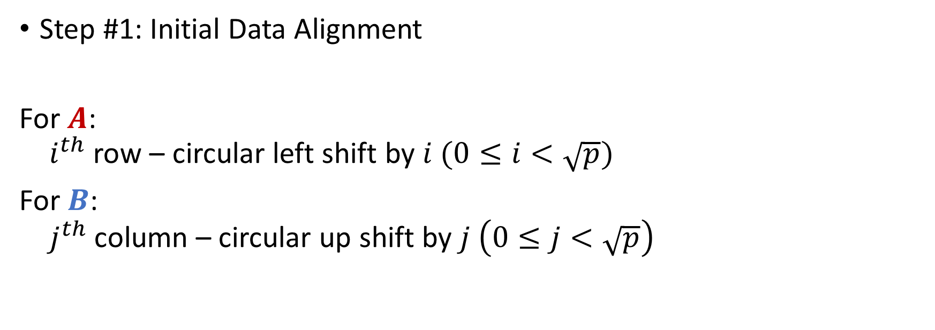
MM on 2D Mesh – Cannon’s Algorithm
Step #1: Initial Data Alignment
For $A$:
$i^{th}$ row – circular left shift by $i (0≤i<\sqrt{p})$
For $B$:
$j^{th}$ column – circular up shift by $j \left(0≤j<\sqrt{p}\right)$

Slide 32




























MM on 2D Mesh – Cannon’s Algorithm
Data Distributed after Step 1?
$$??$$
$$??$$
$$??$$
$$??$$
$$??$$
$$??$$
$$??$$
$$??$$
$$??$$
$$??$$
$$??$$
$$??$$
$$??$$
$$??$$
$$??$$
$$??$$
$$??$$
$$??$$
$$??$$
$$??$$
$$??$$
$$??$$
$$??$$
$$??$$
$$??$$
$$??$$
$$??$$
$$??$$
$$??$$
$$??$$
$$??$$
$$??$$

Slide 33
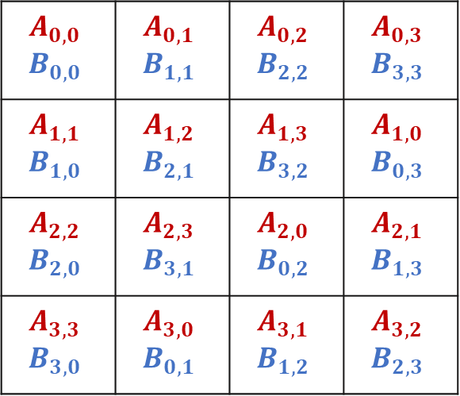
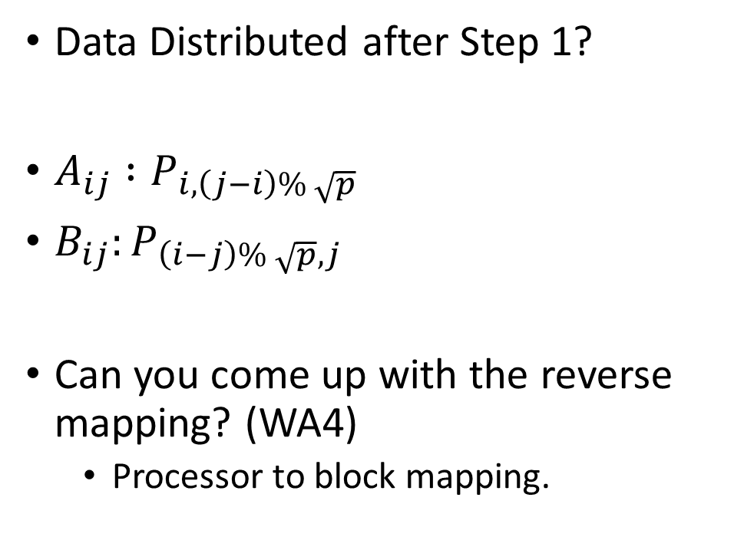
MM on 2D Mesh – Cannon’s Algorithm
Data Distributed after Step 1?
$A_{ij} :P_{i,\left(j−i\right)\% \sqrt{p}}$
$B_{ij}:P_{\left(i−j\right)\% \sqrt{p}, j}$
Can you come up with the reverse mapping? (WA4)
Processor to block mapping.
$$A_{0,0}$$ $$B_{0,0}$$ | $$A_{0,1}$$ $$B_{1,1}$$ | $$A_{0,2}$$ $$B_{2,2}$$ | $$A_{0,3}$$ $$B_{3,3}$$
$$A_{1,1}$$ $$B_{1,0}$$ | $$A_{1,2}$$ $$B_{2,1}$$ | $$A_{1,3}$$ $$B_{3,2}$$ | $$A_{1,0}$$ $$B_{0,3}$$
$$A_{2,2}$$ $$B_{2,0}$$ | $$A_{2,3}$$ $$B_{3,1}$$ | $$A_{2,0}$$ $$B_{0,2}$$ | $$A_{2,1}$$ $$B_{1,3}$$
$$A_{3,3}$$ $$B_{3,0}$$ | $$A_{3,0}$$ $$B_{0,1}$$ | $$A_{3,1}$$ $$B_{1,2}$$ | $$A_{3,2}$$ $$B_{2,3}$$

Slide 34
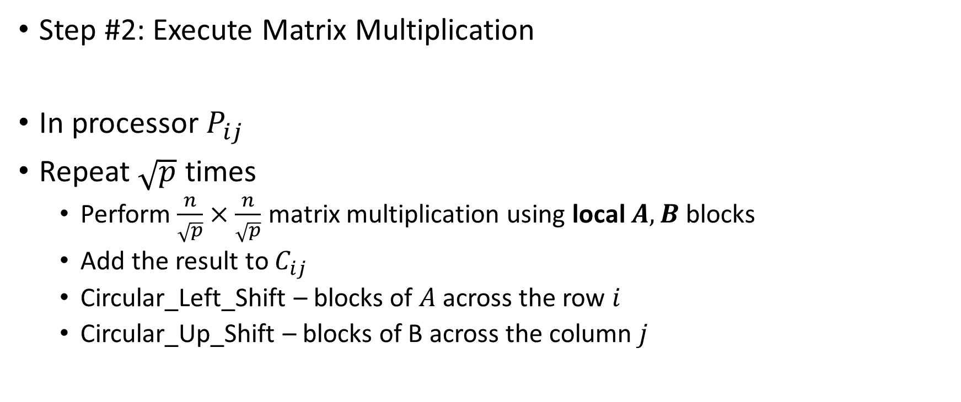
MM on 2D Mesh – Cannon’s Algorithm
Step #2: Execute Matrix Multiplication
In processor $P_{ij}$
Repeat $\sqrt{p}$ times
Perform $\frac{n}{\sqrt{p}}×\frac{n}{\sqrt{p}}$ matrix multiplication using local $A,B$ blocks
Add the result to $C_{ij}$
Circular_Left_Shift – blocks of $A$ across the row $i$
Circular_Up_Shift – blocks of B across the column $j$

Slide 35




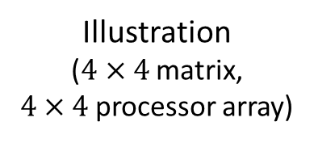
MM on 2D Mesh – Cannon’s Algorithm
Illustration
($4×4$matrix,
$4×4$processor array)
After Initial Alignment
Step 1
Compute product of local blocks
Circular left shift
Circular up shift
Repeat
$$A_{0,0}$$
$$A_{0,1}$$
$$A_{0,2}$$
$$A_{0,3}$$
$$B_{0,0}$$
$$B_{1,1}$$
$$B_{2,2}$$
$$B_{3,3}$$
$$A_{1,1}$$
$$A_{1,2}$$
$$A_{1,3}$$
$$A_{1,0}$$
$$B_{1,0}$$
$$B_{2,1}$$
$$B_{3,2}$$
$$B_{0,3}$$
$$A_{2,2}$$
$$A_{2,3}$$
$$A_{2,0}$$
$$A_{2,1}$$
$$B_{2,0}$$
$$B_{3,1}$$
$$B_{0,2}$$
$$B_{1,3}$$
$$A_{3,3}$$
$$A_{3,0}$$
$$A_{3,1}$$
$$A_{3,2}$$
$$B_{3,0}$$
$$B_{0,1}$$
$$B_{1,2}$$
$$B_{2,3}$$
$$B_{0,0}$$
$$B_{1,1}$$
$$B_{2,2}$$
$$B_{3,3}$$

Slide 36






























MM on 2D Mesh – Cannon’s Algorithm
$$A_{0,2}$$
$$A_{0,3}$$
$$A_{0,0}$$
$$A_{0,1}$$
After Initial Alignment
Step 2
Compute product of local blocks
Circular left shift
Circular up shift
Repeat
$$B_{2,0}$$
$$B_{3,1}$$
$$B_{0,2}$$
$$B_{1,3}$$
$$A_{1,3}$$
$$A_{1,0}$$
$$A_{1,1}$$
$$A_{1,2}$$
$$B_{3,0}$$
$$B_{0,1}$$
$$B_{1,2}$$
$$B_{2,3}$$
$$A_{2,0}$$
$$A_{2,1}$$
$$A_{2,2}$$
$$A_{2,3}$$
$$B_{0,0}$$
$$B_{1,1}$$
$$B_{2,2}$$
$$B_{3,3}$$
$$A_{3,1}$$
$$A_{3,2}$$
$$A_{3,3}$$
$$A_{3,0}$$
$$B_{1,0}$$
$$B_{2,1}$$
$$B_{3,2}$$
$$B_{0,3}$$
$$B_{0,0}$$
$$B_{1,1}$$
$$B_{2,2}$$
$$B_{3,3}$$

Slide 37
MM on 2D Mesh – Cannon’s Algorithm
$$A_{0,2}$$
$$A_{0,3}$$
$$A_{0,0}$$
$$A_{0,1}$$
After Initial Alignment
Step 3
Compute product of local blocks
Circular left shift
Circular up shift
Repeat
$$B_{2,0}$$
$$B_{3,1}$$
$$B_{0,2}$$
$$B_{1,3}$$
$$A_{1,3}$$
$$A_{1,0}$$
$$A_{1,1}$$
$$A_{1,2}$$
$$B_{3,0}$$
$$B_{0,1}$$
$$B_{1,2}$$
$$B_{2,3}$$
$$A_{2,0}$$
$$A_{2,1}$$
$$A_{2,2}$$
$$A_{2,3}$$
$$B_{0,0}$$
$$B_{1,1}$$
$$B_{2,2}$$
$$B_{3,3}$$
$$A_{3,1}$$
$$A_{3,2}$$
$$A_{3,3}$$
$$A_{3,0}$$
$$B_{1,0}$$
$$B_{2,1}$$
$$B_{3,2}$$
$$B_{0,3}$$
$$B_{0,0}$$
$$B_{1,1}$$
$$B_{2,2}$$
$$B_{3,3}$$

Slide 38















MM on 2D Mesh – Cannon’s Algorithm
$$A_{0,3}$$
$$A_{0,0}$$
$$A_{0,1}$$
$$A_{0,2}$$
After Initial Alignment
Step 4
Compute product of local blocks
Circular left shift
Circular up shift
End
$$B_{3,0}$$
$$B_{0,1}$$
$$B_{1,2}$$
$$B_{2,3}$$
$$A_{1,0}$$
$$A_{1,1}$$
$$A_{1,2}$$
$$A_{1,3}$$
$$B_{0,0}$$
$$B_{1,1}$$
$$B_{2,2}$$
$$B_{3,3}$$
$$A_{2,1}$$
$$A_{2,2}$$
$$A_{2,3}$$
$$A_{2,0}$$
$$B_{1,0}$$
$$B_{2,1}$$
$$B_{3,2}$$
$$B_{0,3}$$
$$A_{3,2}$$
$$A_{3,3}$$
$$A_{3,0}$$
$$A_{3,1}$$
$$B_{2,0}$$
$$B_{3,1}$$
$$B_{0,2}$$
$$B_{1,3}$$
$$B_{0,0}$$
$$B_{1,1}$$
$$B_{2,2}$$
$$B_{3,3}$$

Slide 39

Performance Analysis (1)
Total Computation time = Number of round $×$ time per round
Number of rounds = $??$
Time per round = $??$
Total Computation time = $??$

Slide 40
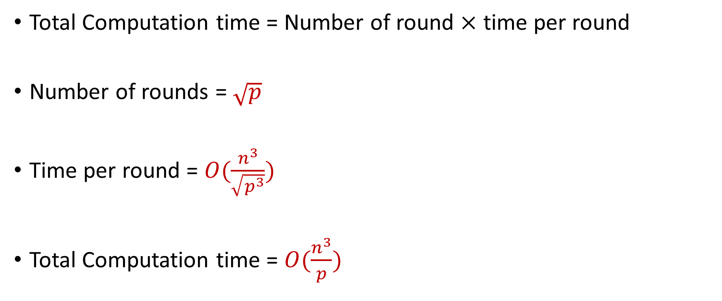
Performance Analysis (1)
Total Computation time = Number of round $×$ time per round
Number of rounds = $\sqrt{p}$
Time per round = $O(\frac{n^{3}}{\sqrt{p^{3}}})$
Total Computation time = $O(\frac{n^{3}}{p})$

Slide 41
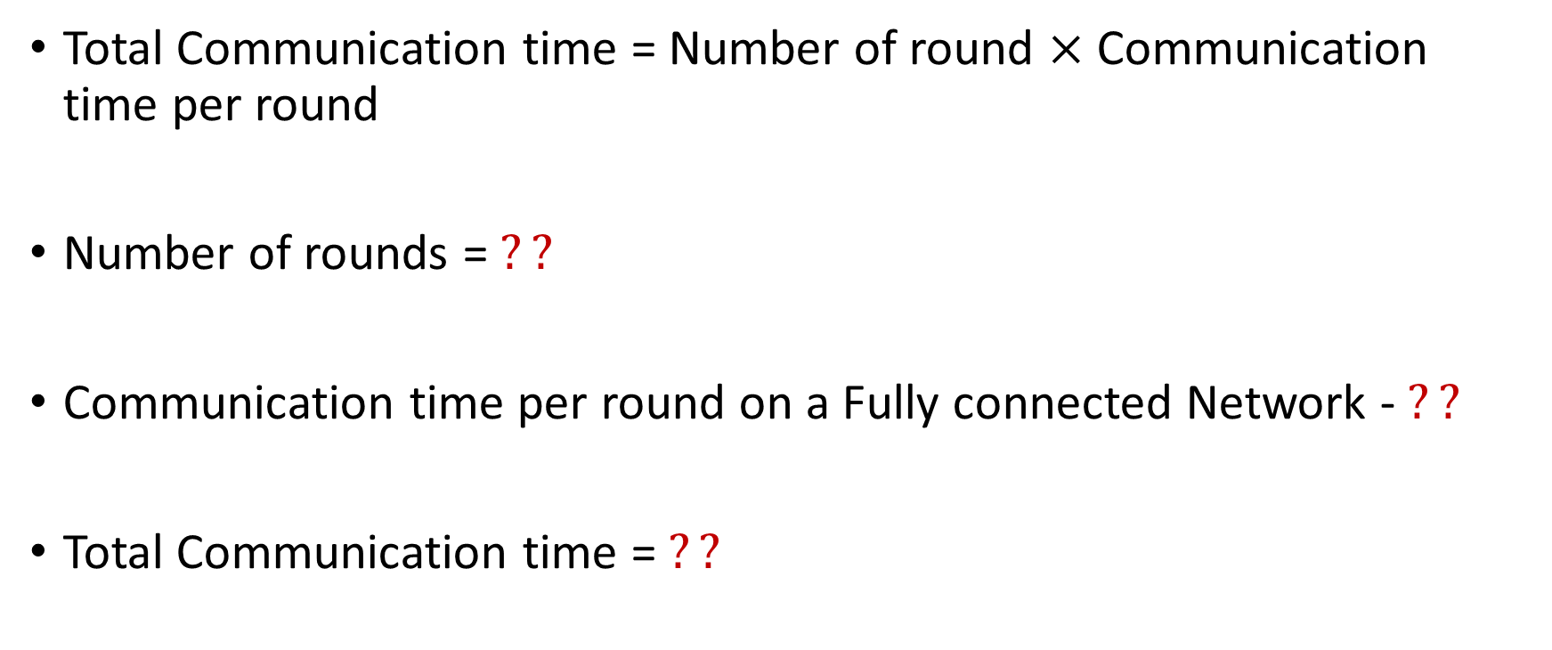
Performance Analysis (2)
Total Communication time = Number of round $×$ Communication time per round
Number of rounds = $??$
Communication time per round on a Fully connected Network - $??$
Total Communication time = $??$

Slide 42
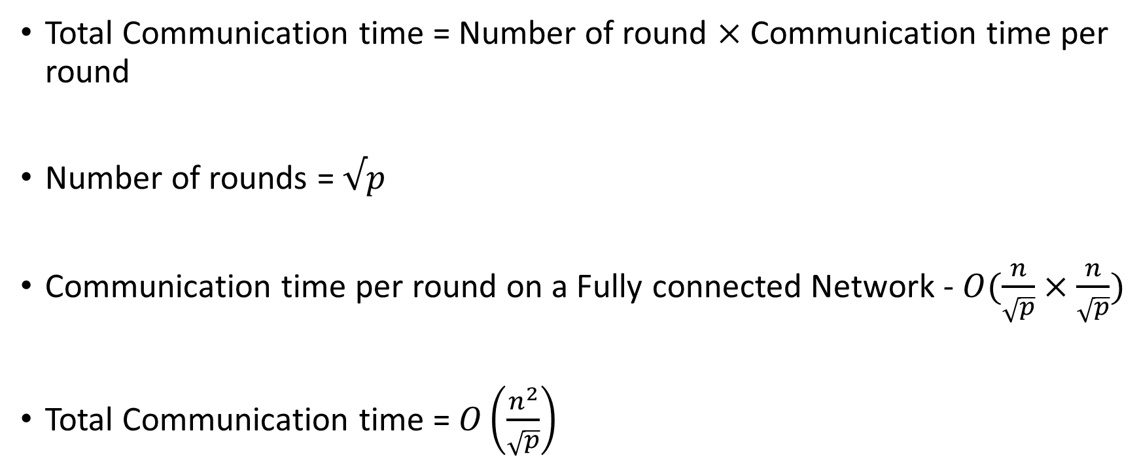
Performance Analysis (2)
Total Communication time = Number of round $×$ Communication time per round
Number of rounds = $√p$
Communication time per round on a Fully connected Network - $O(\frac{n}{\sqrt{p}}×\frac{n}{\sqrt{p}})$
Total Communication time = $O\left(\frac{n^{2}}{\sqrt{p}}\right)$

Slide 43
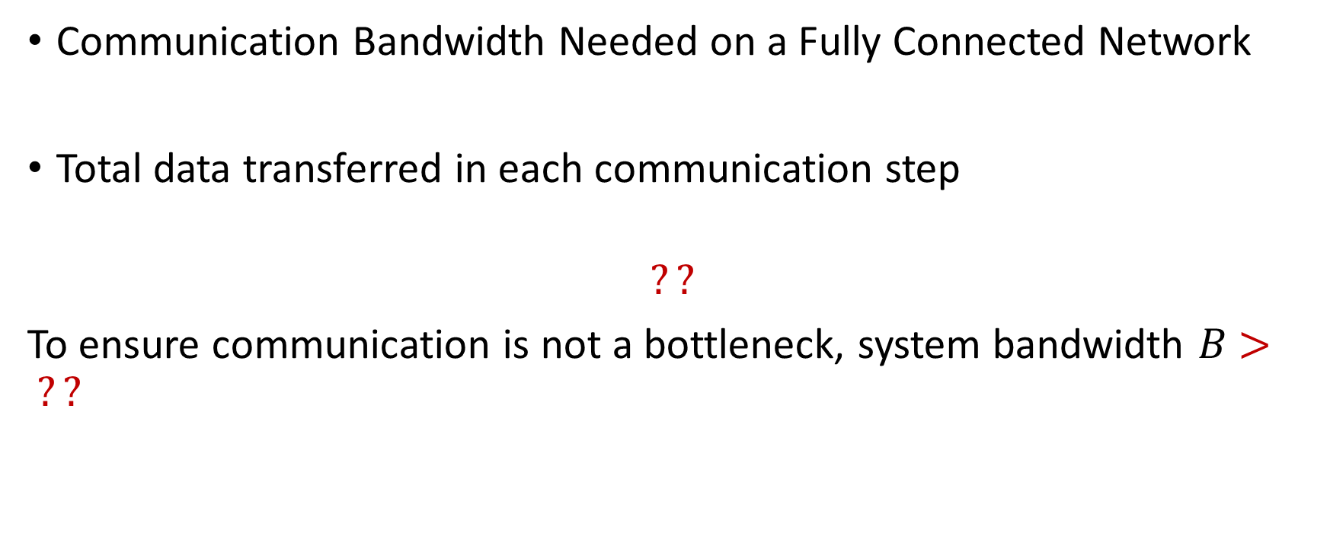
Performance Analysis (3)
Communication Bandwidth Needed on a Fully Connected Network
Total data transferred in each communication step
$$??$$
To ensure communication is not a bottleneck, system bandwidth $B$ $> ??$

Slide 44
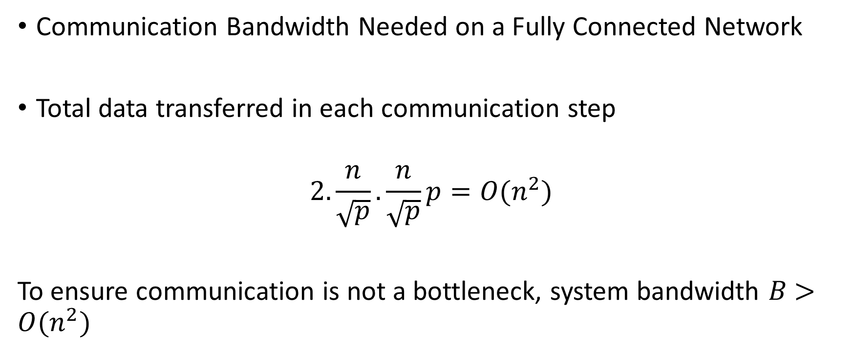
Performance Analysis (3)
Communication Bandwidth Needed on a Fully Connected Network
Total data transferred in each communication step
$$2.\frac{n}{\sqrt{p}}.\frac{n}{\sqrt{p}}p=O(n^{2})$$
To ensure communication is not a bottleneck, system bandwidth $B$ $>O(n^{2})$

Slide 45

Performance Analysis (4)
In other words, the largest size of matrix that can be solved using $p$ processors on this system, using this algorithm is:
$$??$$

Slide 46

Performance Analysis (5)
In other words, the largest size of matrix that can be solved using $p$ processors on this system, using this algorithm is:
$$\sqrt{B}×√B$$

Slide 47
Outline
Distributed Matrix Multiplication on Cluster
Collective Communication Primitives

Slide 48
Collective Communication (1)
Writing programs with send/receive can get too cumbersome
Difficult to optimize
If every process needs to be involved in communication, a higher level of abstraction is desired
Collective Communication API: Communications involving group of processors

Slide 49
Collective Communication (2)
Called by ALL the processors
Each processor should call the same API with same size of buffer
If a call is missing in one of the processors, it may lead to undefined behavior
One program in EACH processor reaches the call, the communication occurs
Examples
Barrier Synchronization (usually not used because other communication operations lead to synchronization)
Broadcast, Scatter, Gather, …
Reduction, All_reduce,…

Slide 50
MPI_Broadcast
Note: ALL processors are calling this function
MPI_Broadcast(buffer, size, root)
Send the data stored in buffer at the root processor to all the processors
Notes:
Image source: https://fs.hlrs.de/projects/par/par_prog_ws/pdf/mpi_3.1_rab.pdf

Slide 51
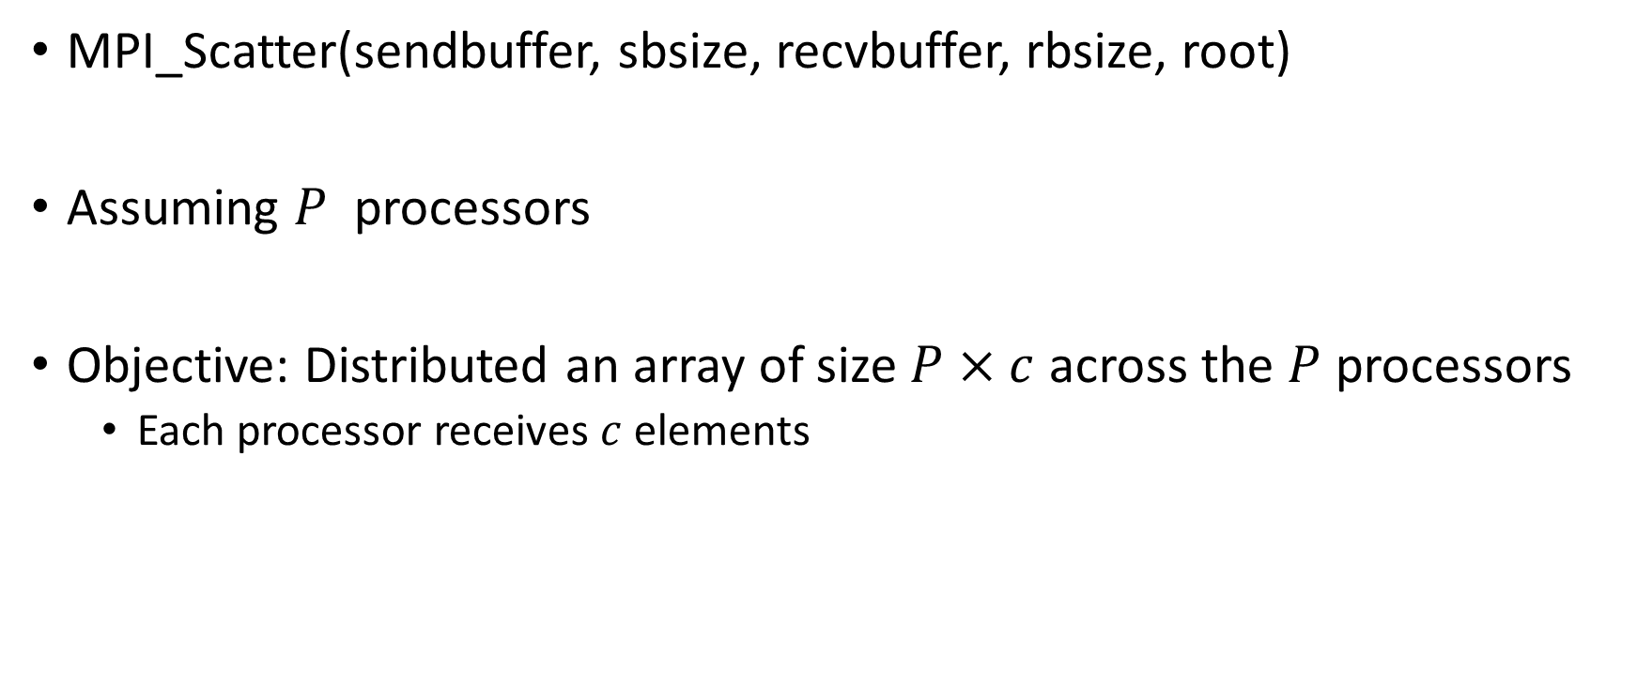
MPI_Scatter
MPI_Scatter(sendbuffer, sbsize, recvbuffer, rbsize, root)
Assuming $P$ processors
Objective: Distributed an array of size $P×c$ across the $P$ processors
Each processor receives $c$ elements

Slide 52
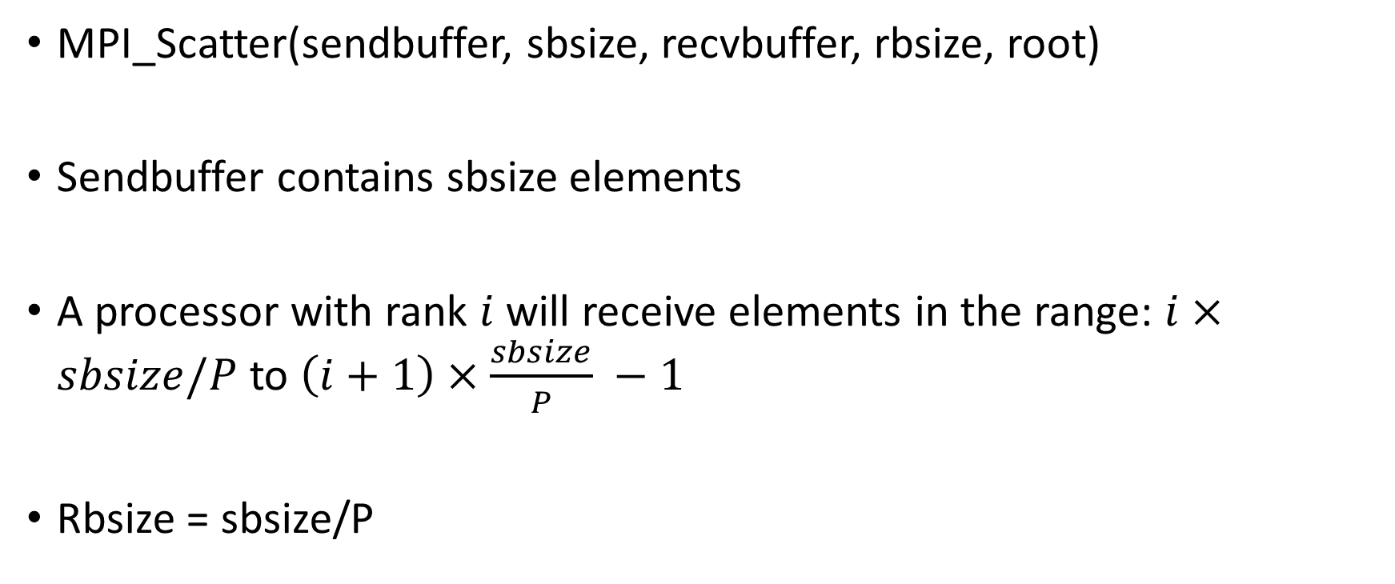
MPI_Scatter
MPI_Scatter(sendbuffer, sbsize, recvbuffer, rbsize, root)
Sendbuffer contains sbsize elements
A processor with rank $i$ will receive elements in the range: $i×sbsize/P$ to $\left(i+1\right)×\frac{sbsize}{P} −1$
Rbsize = sbsize/P

Slide 53
MPI_Scatter

Slide 54
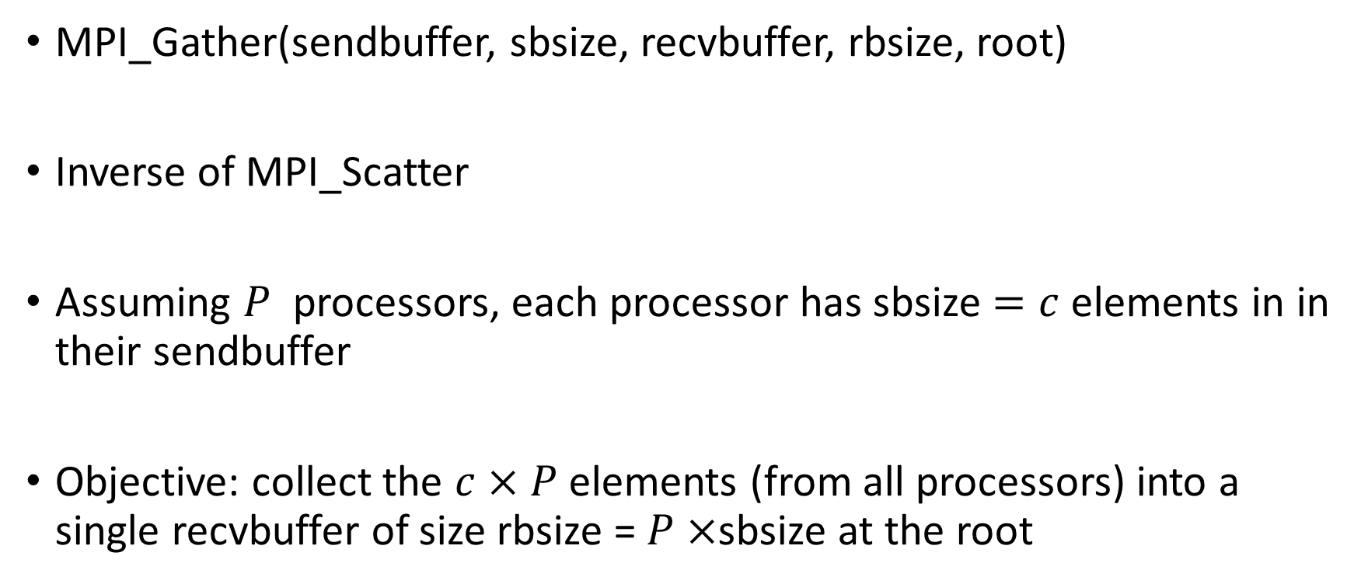
MPI_Gather
MPI_Gather(sendbuffer, sbsize, recvbuffer, rbsize, root)
Inverse of MPI_Scatter
Assuming $P$ processors, each processor has sbsize $=c$ elements in in their sendbuffer
Objective: collect the $c×P$ elements (from all processors) into a single recvbuffer of size rbsize = $P×$sbsize at the root

Slide 55
MPI_Gather

Slide 56
MPI_Reduce
MPI_Reduce(inbuf, ibsize, resultbuf, rbsize, Aggr_op, root)
Performs a global reduction operation with a specified aggregation function and stores the result at the root
Inbuf: buffer that stores elements in each processor that will be aggregated
Resultbuf: buffer in the root processor that stores the aggregated results

Slide 57
MPI_Reduce
Examples of Aggregation Operations?

Slide 58
MPI_Reduce
Examples of Aggregation Operations?
Sum
Product
Min
Max
…

Slide 59

MPI_Reduce
Inbuf P0
Inbuf P1
Inbuf $P_{p}$
Reduction Occurs Elementwise in vectors

Slide 60
MPI_Reduce
Inbuf P0
Inbuf P1
Inbuf $P_{p}$
Reduction Occurs Elementwise in vectors

Slide 61
MPI_Reduce
ResultBuf root-processor
Reduction Occurs Elementwise in vectors

Slide 62
MPI_Reduce

Slide 63
MPI_Reduce
Does the order of Rank matter in Reduction?
P0: A, P1: B, P2: C
P0: B P1: C, P2: A
MPI_Reduce() – same results or different?

Slide 64
MPI_Reduce
Does the order of Rank matter in Reduction?
P0: A, P1: B, P2: C
P0: B P1: C, P2: A
MPI_Reduce() – same results.

Slide 65
MPI_AllReduce
MPI_AllReduce(inbuf, resultbuf, size)
Same as MPI_Reduce() but stores the results in all the processors
Equivalent to:
MPI_Reduce(inbuf, ibsize, resultbuf, rbsize, Aggr_op, root)
MPI_Scatter(resultbuf, rbsize, root )

Slide 66
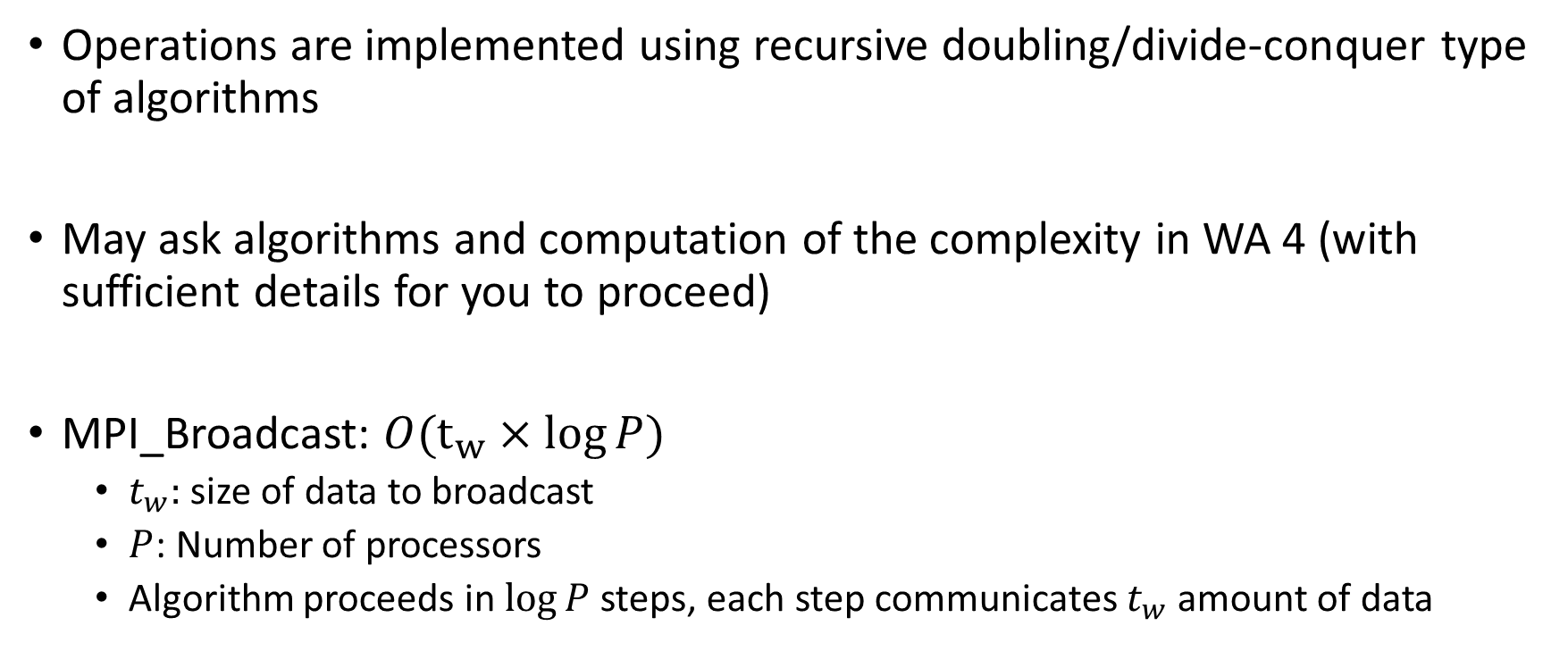
Collective Operations Communication Complexity (1)
Operations are implemented using recursive doubling/divide-conquer type of algorithms
May ask algorithms and computation of the complexity in WA 4 (with sufficient details for you to proceed)
MPI_Broadcast: $O(t_{w}×log{P)}$
$t_{w}:$ size of data to broadcast
$P$: Number of processors
Algorithm proceeds in $\log{P}$ steps, each step communicates $t_{w}$ amount of data

Slide 67
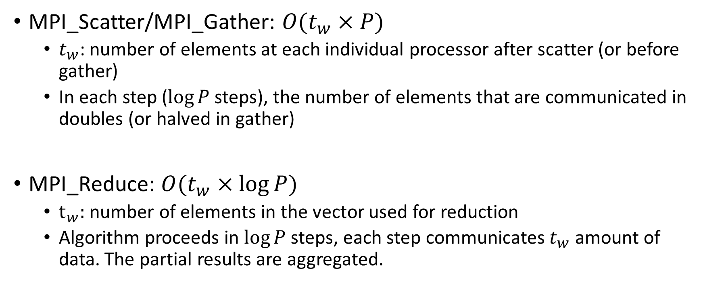
Collective Operations Communication Complexity (2)
MPI_Scatter/MPI_Gather: $O(t_{w}×P)$
$t_{w}$: number of elements at each individual processor after scatter (or before gather)
In each step ($\log{P}$ steps), the number of elements that are communicated in doubles (or halved in gather)
MPI_Reduce: $O(t_{w}×\log{P})$
$t_{w}:$ number of elements in the vector used for reduction
Algorithm proceeds in $\log{P}$ steps, each step communicates $t_{w}$ amount of data. The partial results are aggregated.

Slide 68
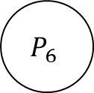
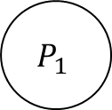
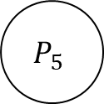






MPI_Broadcast
$$P_{0}$$
$$P_{1}$$
$$P_{2}$$
$$P_{3}$$
$$P_{4}$$
$$P_{5}$$
$$P_{6}$$
$$P_{7}$$
Data initially at $P_{0}$

Slide 69
MPI_Broadcast
$$P_{0}$$
$$P_{1}$$
$$P_{2}$$
$$P_{3}$$
$$P_{4}$$
$$P_{5}$$
$$P_{6}$$
$$P_{7}$$
Step 1

Slide 70
MPI_Broadcast
$$P_{0}$$
$$P_{1}$$
$$P_{2}$$
$$P_{3}$$
$$P_{4}$$
$$P_{5}$$
$$P_{6}$$
$$P_{7}$$
Step 2

Slide 71
MPI_Broadcast
$$P_{0}$$
$$P_{1}$$
$$P_{2}$$
$$P_{3}$$
$$P_{4}$$
$$P_{5}$$
$$P_{6}$$
$$P_{7}$$
Step 3

Slide 72

MPI_Scatter
$$P_{0}$$
$$P_{1}$$
$$P_{2}$$
$$P_{3}$$
$$P_{4}$$
$$P_{5}$$
$$P_{6}$$
$$P_{7}$$
Data initially at $P_{0}$
Notice the size

Slide 73
MPI_Scatter
$$P_{0}$$
$$P_{1}$$
$$P_{2}$$
$$P_{3}$$
$$P_{4}$$
$$P_{5}$$
$$P_{6}$$
$$P_{7}$$
Step 1

Slide 74
MPI_Scatter
$$P_{0}$$
$$P_{1}$$
$$P_{2}$$
$$P_{3}$$
$$P_{4}$$
$$P_{5}$$
$$P_{6}$$
$$P_{7}$$
Step 2

Slide 75
MPI_Scatter
$$P_{0}$$
$$P_{1}$$
$$P_{2}$$
$$P_{3}$$
$$P_{4}$$
$$P_{5}$$
$$P_{6}$$
$$P_{7}$$
Step 3

Slide 76
MPI_Reduce
$$P_{0}$$
$$P_{1}$$
$$P_{2}$$
$$P_{3}$$
$$P_{4}$$
$$P_{5}$$
$$P_{6}$$
$$P_{7}$$
Initial data

Slide 77
MPI_Reduce
$$P_{0}$$
$$P_{1}$$
$$P_{2}$$
$$P_{3}$$
$$P_{4}$$
$$P_{5}$$
$$P_{6}$$
$$P_{7}$$
Step 1

Slide 78
MPI_Reduce
$$P_{0}$$
$$P_{1}$$
$$P_{2}$$
$$P_{3}$$
$$P_{4}$$
$$P_{5}$$
$$P_{6}$$
$$P_{7}$$
Step 1

Slide 79
MPI_Reduce
$$P_{0}$$
$$P_{1}$$
$$P_{2}$$
$$P_{3}$$
$$P_{4}$$
$$P_{5}$$
$$P_{6}$$
$$P_{7}$$
Step 2

Slide 80
MPI_Reduce
$$P_{0}$$
$$P_{1}$$
$$P_{2}$$
$$P_{3}$$
$$P_{4}$$
$$P_{5}$$
$$P_{6}$$
$$P_{7}$$
Step 2

Slide 81
MPI_Reduce
$$P_{0}$$
$$P_{1}$$
$$P_{2}$$
$$P_{3}$$
$$P_{4}$$
$$P_{5}$$
$$P_{6}$$
$$P_{7}$$
Step 3

Slide 82
MPI_Reduce
$$P_{0}$$
$$P_{1}$$
$$P_{2}$$
$$P_{3}$$
$$P_{4}$$
$$P_{5}$$
$$P_{6}$$
$$P_{7}$$
Step 3

Slide 83

Collective Communication Operation Example
Ungraded HW Assignment (may ask in WA 4)
Calculate the average of an array of size $P$ using $P$ processors
Initial data mapping: Each processor owns one element of the array
Approach #1:
P0 performs MPI_Gather
P0 calculates the average of the gathered array
P0 performs MPI_Scatter of the average

Slide 84

Collective Communication Operation Example
Approach #2
P0 performs MPI_Reduce with MPI_SUM as aggregation operation
P0 divides the aggregated value by $P$ (number of processors) to obtain
P0 performs MPI_Broadcast of the average
What is the communication time complexity of these two approaches?
Which approach is better?

Slide 85
Next Class
11/13 Lecture 22
Communication Complexity of Communication Collectives
Distribute Training Parallelism Paradigms – Implementation Using Communication Primitives

Slide 86
Thank You
Questions?
Email: sanmukh.kuppannagari@case.edu

